Slide 1
Trends and spatial patterns of drought incidence in the Omo-Ghibe River Basin, Ethiopia
Policy Brief
Degefu MA. & Bewket W.

Slide 2
Contents
Introduction
Methodology
Findings
Recommendations and policy implications

Slide 3
Introduction
Drought is a recurrent feature of climate that occurs over most parts of the world and in all types of climates (Mpelasoka et al., 2008; Dai, 2011)
Although it has many definitions, drought can be best characterized as a period of abnormally dry weather due to lack of precipitation
The socioeconomic and environmental impacts of droughts are determined by its intensity, frequency, duration and spatial coverage (Bannayan et al., 2010)
Empirical and modeling studies confirmed that climate change is very likely to enhance the intensity, frequency and duration of droughts over some parts of the world

Slide 4
Cont…
Drought is a very common socio-economic and environmental problem since a long time (Block 2008)
It has caused severe water shortage for crop and pasture growth, food insecurity, mass animal death, disease outbreak and conflicts between communities
Despite the fact that drought is the most damaging natural hazard in Ethiopia, very little is known about its spatio-temporal characteristics
The objective of this study therefore is to analyze magnitude, frequency, spatial variability and trends of drought events in the Omo-Ghibe River Basin, which is located in the southwestern part of Ethiopia

Slide 5
Methodology
Drought Indices
There are many drought indices: Palmer Drought Severity Index (PDSI), the Rainfall Deciles Index (RDI), Standardized Precipitation Index (SPI), Soil Moisture Index (SMI), Drought Severity Index (DSI)
In this study the SPI was applied for its multiple advantages
It allows drought conditions to be described for a range of (3-, 6-, 12, and 24-month) meteorological, agricultural and hydrological applications
SPI is also powerful to compare drought events across space and time at a given region, require only monthly RF data and simple to compute

Slide 6
Data and method
Monthly rainfall data were obtained from the Ethiopian National Meteorological Agency for eight stations for the period 1972–2007
SPI values were computed to quantify drought events at 3-, 6-, 12- and 24-month time scales to represent agricultural and hydrological droughts using SPI_SL.6.exe program
IPS generated indices at three intensity classess: (SPI= 0 to -0.99), moderate drought (SPI= -1.00 to -1.49), severe drought (-1.50 to -1.99), and extreme drought (SPI -2.00 or less)
For mapping of the spatial extent of droughts from point data, an inverse distance weighted interpolation method
Mann-Kendall’s test was applied to detecting trends

Slide 7
Findings
The frequency and magnitude of drought events computed at all time scales (3-, 6-, 12- and 24-months) and intensity classes showed complex and localized spatial patterns
However, the southern part of the River Basin has experienced the most recurrent drought risks during the study period
Over southern lowlands it cause chronic water and pasture shortages, food insecurity and conflicts between pastoral communities
The most extreme (SPI < -4.0) and prolonged drought events for all time observed at Wolaita Sodo area
It caused significant adverse effects on crop production and subsequent food shortages in the most densely populated areas

Slide 8
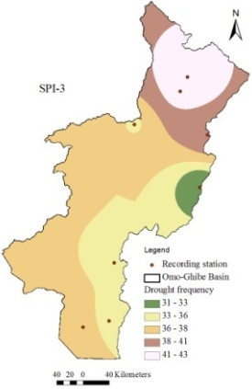
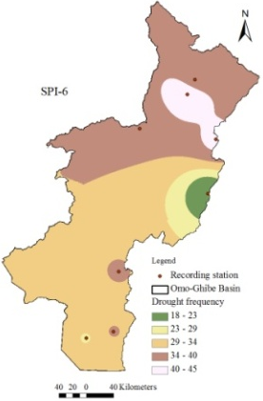
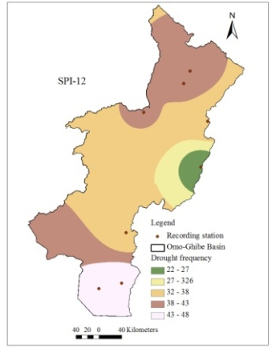
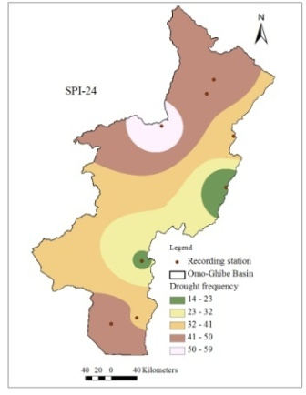
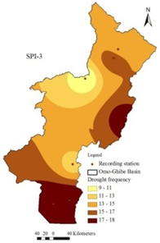
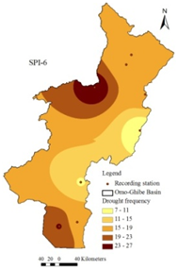
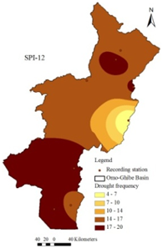
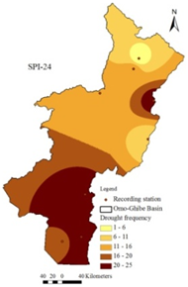
a)
b)
Figure 2. The spatial patterns of a) moderate and b) severe drought events

Slide 9
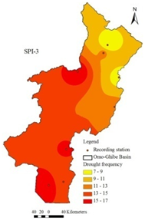
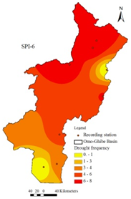
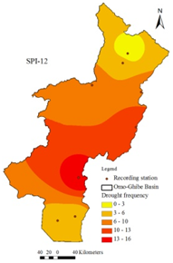
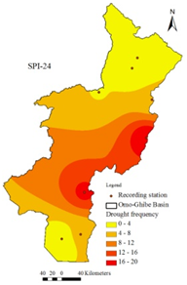
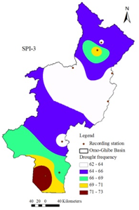
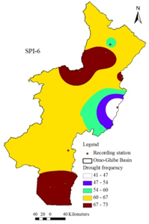
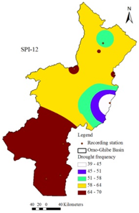
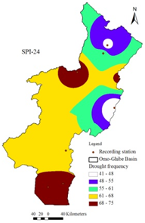
a)
b)
Figure 2.The spatial patterns of a) extreme intensity and b) total drought events

Slide 10
Recommendations and policy implications
The government will need to develop appropriate policy and strategic interventions to effectively manage the local scale drought events
The government should develop local scale drought response and water management policies and strategies: based on the nature of impacts (water shortage, food security and conflict) government should developed different locale scale drought and water management intervention strategies
The government should develop mechanism to generate locale scale drought forecasting and early warning systems: there should fine spatial scale rainfall and drought forecasting and early warning systems in the country

Slide 11
Cont…
Develop appropriate strategies to reduce frequent drought risks for the southern Omo lowland: policy intervention in the southern part of Omo should be in a way to reduces frequent drought impacts

Slide 12
Thank you
Question?

